Slide 1

Sentiment Analysis of IMDB Reviews
Indraneel Mane, Ruoxi Pan

Slide 2
Goal of project
The goal of our project is to provide insights about the sentiments associated with texts like reviews, feedbacks etc. This can help large enterprises to understand their customers and provide better experience.
In order to achieve this, we learn various different algorithms used for classification, by applying packages and also implement our own algorithms so that we are getting more understanding of the classification algorithms.

Slide 3
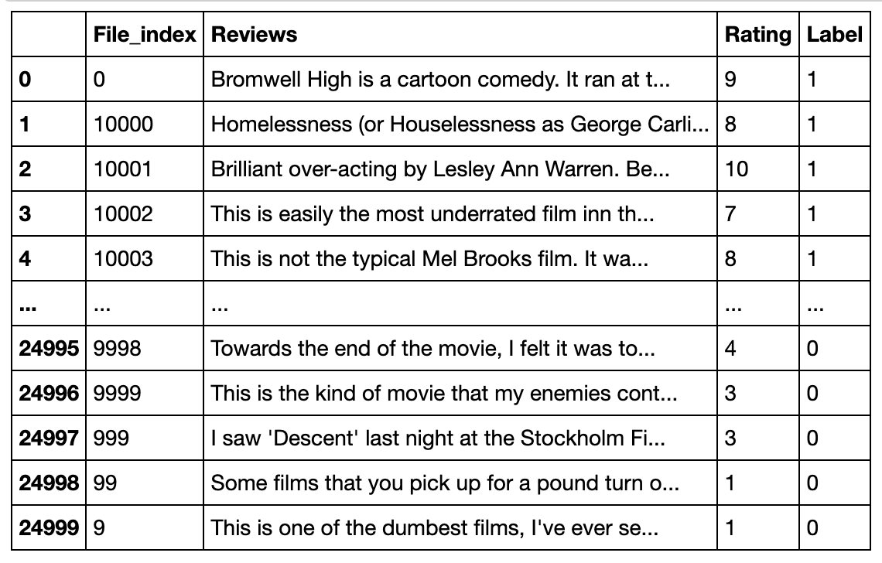
Dataset
Training Set Snapshot
Notes:
Dataset is downloaded from the Stanford website.
The core dataset contains 50,000 reviews split evenly into 25k train and 25k test sets. The overall distribution of labels is balanced (25k pos and 25k neg)
This dataset contains movie reviews along with their associated ratings from 1 to 10 and binary sentiment polarity labels.
In the labeled train/test sets, a negative review has a score <= 4 out of 10, and a positive review has a score >= 7 out of 10.

Slide 4
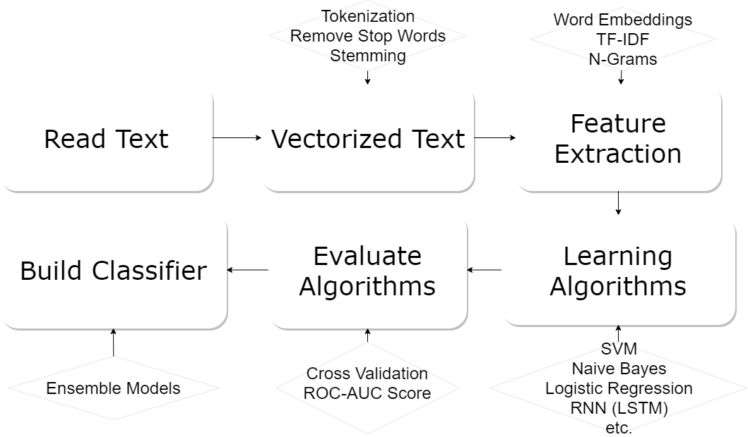
Overview

Slide 5
Preprocessing V.S No Preprocessing

Slide 6
Results Without Preprocessing
Logistic regression - 0.52152
Support vector machine - 0.52472

Slide 7
Data Cleaning and Preprocessing
1] Removing html tags
2] Converting all text to lowercase
3] Tokenize all texts
4] Remove stop words and punctuation
5] Adding parts of speech to each word
6] Lemmatize tokens
7] Join all token to get final cleaned text.

Slide 8
Feature Extraction
- Bag of Words
- TF-IDF

Slide 9
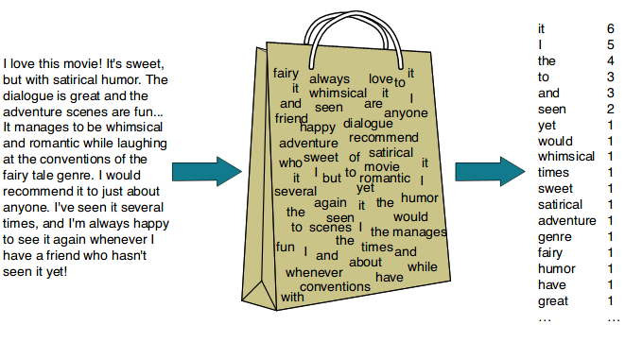
BOW (Bag of words)
Countvectorizer
Notes:
BOW means that its word order, grammar and syntax are ignored, and this text is only treated as a collection of words, so the BOW method does not adequately represent the semantic information of the text.
For example, the sentence "This movie is awful" and "a boring, empty, non-connotative work" have a high semantic similarity in sentiment analysis, but their BOW representation has a similarity of zero. Another example is that the BOW is very similar to the sentence "an empty, work without connotations" and "a work that is not empty and has connotations", but in fact they mean differently.

Slide 10
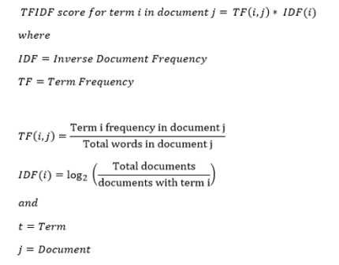
TF-IDF
Notes:
In CountVectorizer we only count the number of times a word appears in the document which results in biasing in favour of most frequent words. this ends up in ignoring rare words which could have helped in processing our data more efficiently.
With the TFIDFVectorizer the value increases proportionally to count, but is offset by the frequency of the word in the corpus. - This is the IDF (inverse document frequency part).
This helps to adjust for the fact that some words appear more frequently.

Slide 11
Deep Learning Architectures
Notes:
So in order to overcome the above shortcomings of BOW representation. We used deep learning architecture to map text to low-dimensional semantic space based on word order, and performs text representation and classification in end-to-end mode.
Its performance is significantly improved compared to the traditional method

Slide 12
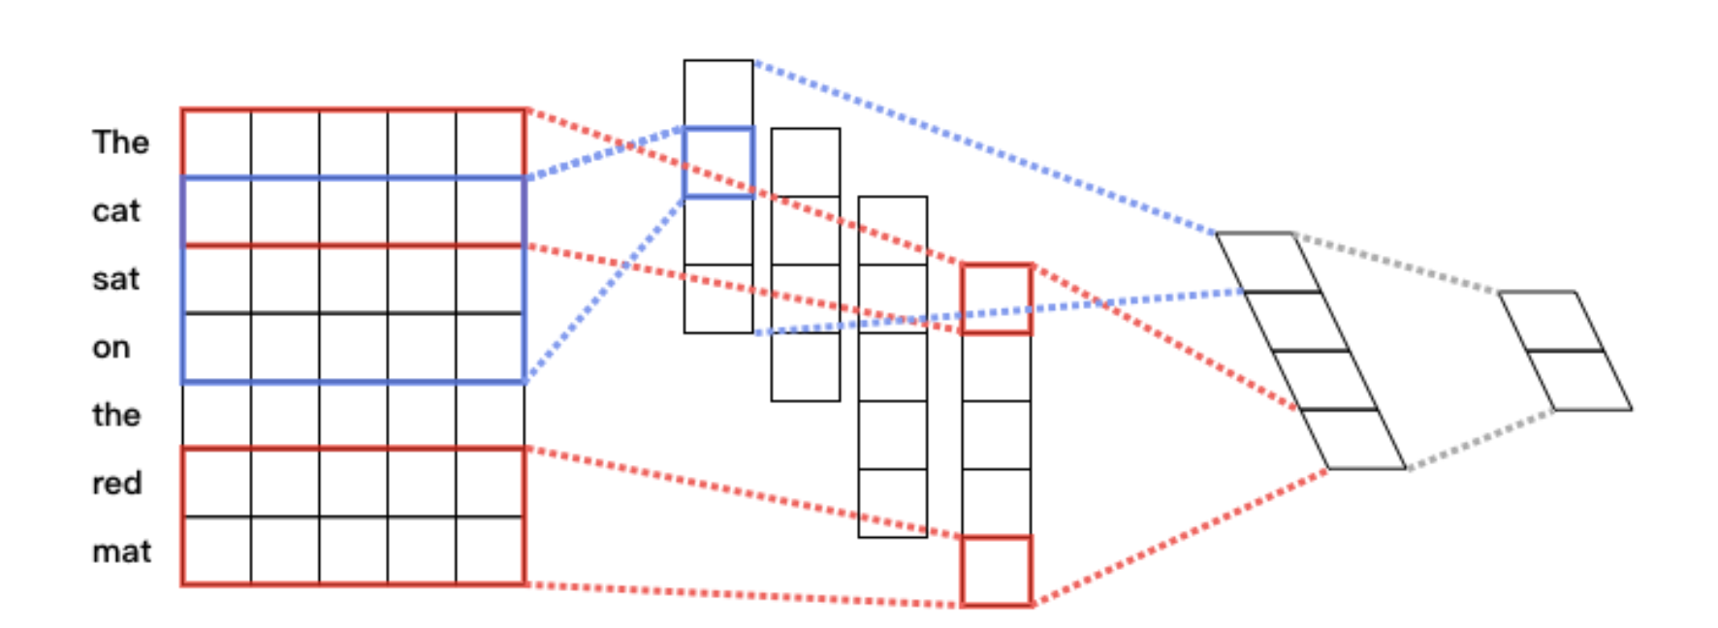
Text Convolutional Neural Network (CNN)
Max Pooling Layer
Fully Connected Layer
Input word vector sequence
Convolution Layer
Notes:
For the CNN, I used the paddlepaddle platform.
1. first convolute input word vector sequence to generate a feature map,
2. and then obtain the features of the whole sentence by using a max pooling on the feature map.
3. Finally, the obtained splicing of all the features is the fixed-length vector representation of the text.
4. For the text classification problem, we then connect it via softmax to construct a complete model.
So our cnn model is composed of 1 embedding layer, 2 convolution layer and 1 dense layer. First filter size equal to 3 and second one equals to 4, then # of filters equal to dimension of the hidden layer, 1 activation function of tanh, and pooling layer with sqrt pooling.

Slide 13
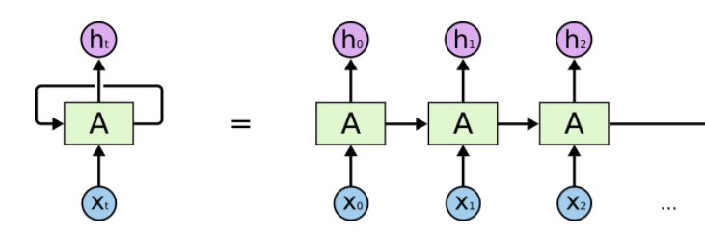
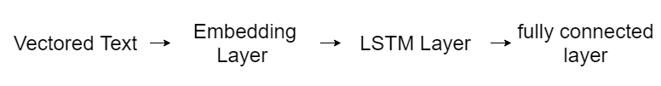
Recurrent Neural Networks (RNN)
Extension: LSTM, Stacked Bidirectional LSTM
Traditional RNN:
Notes:
Long short-term memory models are a type of recurrent neural network. In recurrent neural networks (RNN), predictions are made sequentially, and the hidden layer from one prediction is fed to the hidden layer of the next prediction. This gives the network ”memory”, in the sense that the results from previous predictions can inform future predictions. LSTMs add additional factors to a traditional RNN that give it more of a fine-grained control over memory. These factors control:
1) how much the current input matters in creating the new memory,
2) how much the previous memories matters in creating the new memory, 3) what parts of the memory are important in generating the output.

Slide 14
Machine learning Algorithms

Slide 15
Model Accuracy
Model | Accuracy | Precision | Recall | f1-Score
Multinomial Naive Bayes | 0.818 | 0.855 | 0.765 | 0.807
Logistic Regression | 0.831 | 0.843 | 0.814 | 0.828
LDA | 0.79 | 0.798 | 0.778 | 0.787
Decision Tree | 0.722 | 0.723 | 0.719 | 0.721
Linear SVC | 0.818 | 0.799 | 0.831 | 0.814
Random Forest (100 estimators) | 0.855 | 0.859 | 0.849 | 0.853
Adaboost with logistic regression (12 estimators) | 0.884 | 0.885 | 0.884 | 0.884

Slide 16
Model | Accuracy
FFNN (3 hidden layers) | 0.855
LSTM | 0.873
Extra Tree | 0.877
Adaboost with decision tree (500 estimators) | 0.842
Gradient boosting | 0.777
XGboost | 0.864
CNN | 0.83
Voting Classifier | 0.89

Slide 17
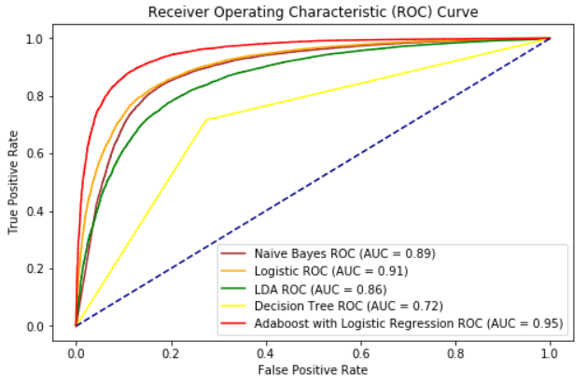
ROC Curve

Slide 18
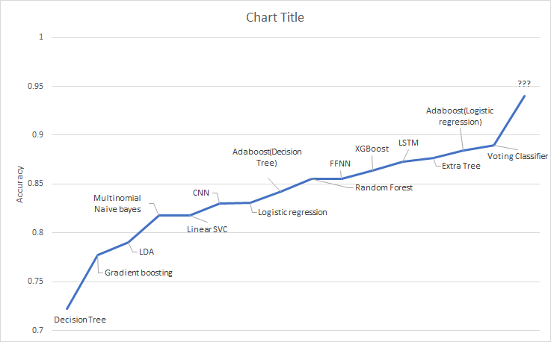

Slide 19
Future Work
Try n-gram models
Bi-LSTM with Attention-mechanism(binary classification)
Improve CNN
Study about other learning algorithms like graph neural net, adversarial training

Slide 20
Thank you! 😊

